Slide 1
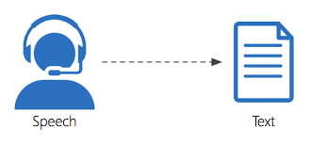
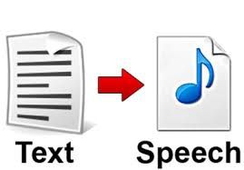
SEMINAR SPEECH RECOGNITION
BY:
RAKAM ARAVIND - 45
RASHI BISHT - 46

Slide 2
ABSTRACT:
In this project, we have converted speech to text and text to speech. It involves the usage of audio file/microphone as input which gives voice as an output (or) any text line as input to be converted to an audio.
The modules used are:
SpeechRecognition
Webbrowser
Pyaudio
Gtts
pocketSphinx

Slide 3
The classes used are:-
1. listen()
2. recognize_google()
3. recognize_sphinx()
4. recognizer()
5. Micrphone()

Slide 4
How speech recognition works?
To convert speech to on-screen text or a computer command, a computer has to go through several complex steps.
When you speak, you create vibrations in the air. The analog-to-digital converter (ADC) translates this analog wave into digital data that the computer can understand.
To do this, it samples, or digitizes, the sound by taking precise measurements of the wave at frequent intervals.
The system filters the digitized sound to remove unwanted noise, and sometimes to separate it into different bands of frequency (frequency is the wavelength of the sound waves, heard by humans as differences in pitch).
It also normalizes the sound, or adjusts it to a constant volume level. It may also have to be temporally aligned. People don't always speak at the same speed, so the sound must be adjusted to match the speed of the template sound samples already stored in the system's memory.

Slide 5
Next the signal is divided into small segments as short as a few hundredths of a second, or even thousandths in the case of plosive consonant sounds -- consonant stops produced by obstructing airflow in the vocal tract -- like "p" or "t." The program then matches these segments to known phonemes in the appropriate language.
A phoneme is the smallest element of a language -- a representation of the sounds we make and put together to form meaningful expressions. There are roughly 40 phonemes in the English language (different linguists have different opinions on the exact number), while other languages have more or fewer phonemes.
The program then determines what the user was probably saying and either outputs it as text or issues a computer command.

Slide 6
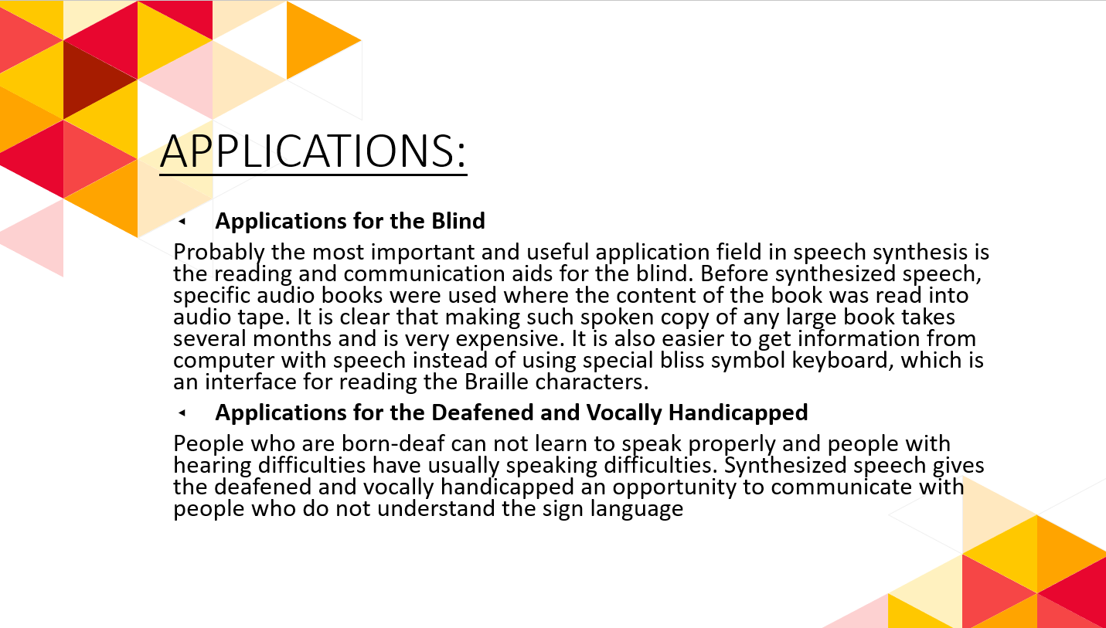

Slide 7
Educational Applications
people who are impaired to read (dyslexics), speech synthesis may be very helpful because especially some children may feel themselves very embarrassing when they have to be helped by a teacher. It is also almost impossible to learn write and read without spoken help. With proper computer software, unsupervised training for these problems is easy and inexpensive to arrange.
Other Applications and Future Directions
In principle, speech synthesis may be used in all kind of human-machine interactions. For example, in warning and alarm systems synthesized speech may be used to give more accurate information of the current situation. Using speech instead of warning lights or buzzers gives an opportunity to reach the warning signal for example from a different room. Speech synthesizer may also be used to receive some desktop messages from a computer, such as printer activity or received e-mail.

Slide 8
Here, we have performed the following conversions :
Local audio file to text
Microphone to text
Use of agents :
- Google
- Youtube
- Edureka
Text to speech

Slide 9
THANK YOU! ☺

